Slide 1


Shift-Left Compliance Agents
Design & Deliverables
Using
Python, SONARQUBE, MongoDB, React, Git
Contributors
Your Photo Goes here
Your Photo Goes here
Mirnal Pratap Singh
Satyam Laheri

Slide 2
Shift-Left Compliance Agents-Design & Deliverables
Layer | Components | Description
Input Layer | Source Code Repository | Java Spring Boot codebase (Git)
Trigger Layer | CI/CD Hook | Pre-build trigger (GitHub Actions / Jenkins)
Scanning Layer | Static Code Analysis | Run SonarQube scan to detect issues
Rule Engine Layer | SONAR Rule Processor | Compare issues against defined rules
AI Agent Layer | Code Fix Generator | Suggest/fix code using AI models
Validation Layer | Code Quality Check | Re-validate fixes via Sonar scan
Automation Layer | Patch Generator | Create PR / commit with fixes
Output Layer | Reports & Logs | Provide compliance report
Dashboard Layer | UI / Monitoring | View issues, fixes, trends
Suggested Tech Stack
Agents
TBD
Backend / AI:
Python
LLM APIs / Open-source models
Code Analysis:
SonarQube
CI/CD:
Jenkins / GitHub Actions
Frontend/UI:
Streamlit / React
Version Control:
Git
Deliverables
CI/CD integrated code scanning pipeline
SONAR rule-based issue detection system
AI-based code fix agent
Automated patch/PR generation
Validation and reporting system
Dashboard for monitoring compliance
Notes:
{
"80C": { "limit": 150000 },
"80D": { "limit": 25000 }
}

Slide 3
Shift-Left Compliance Agents: Things to do
Phase 1: Requirement Analysis
Define:
Scope of compliance (Sonar rules, security, code quality)
Identify:
Supported languages (Java Spring Boot)
Define:
CI/CD integration points
Phase 4: SONAR Rule Engine
Extract:
Sonar issues (bugs, vulnerabilities, code smells)
Map:
Issues → rules
Categorize:
Severity (low, medium, high)
Start: 26.03.2026
End: 27.03.2026
Start: 30.03.2026
End: 31.03.2026
Phase 5: AI Agent Development (Core)
Build AI agent to:
Analyze code issues
Suggest fixes
Use:
LLMs / code models (Open-source or APIs)
Example:
Fix null pointer issues
Improve code formatting
Phase 2: Environment Setup
Setup:
SonarQube server
Sample Java Spring Boot project
Configure:
Sonar scanner
Start: 1.04.2026
End: 3.04.2026
Start: 27.03.2026
End: 29.03.2026
Phase 3: Code Scanning Integration
Integrate SonarQube with:
CI/CD pipeline (Jenkins / GitHub Actions)
Run scans:
Before build (shift-left approach)
Start: 30.03.2026
End: 31.03.2026
Notes:
1.

Slide 4
Shift-Left Compliance Agents: Things to do
Phase 6: Automated Code Fixing
Generate:
Code patches
Apply:
Suggested fixes automatically (or semi-automated)
Create:
Pull requests / commits
Phase 9: Dashboard / UI
Build using:
Streamlit / Web UI
Display:
Issue trends
Fix success rate
Code quality metrics
Start: 4.04.2026
End: 6.04.2026
Start: 15.04.2026
End: 19.04.2026
Phase 7: Validation Loop
Re-run:
Sonar scan after fixes
Ensure:
Issues reduced
Track:
Before vs after metrics
Phase 10: Testing & Evaluation
Test:
Different codebases
Validate:
Accuracy of fixes
Reduction in issues
Start: 6.04.2026
End: 9.04.2026
Start: 20.04.2026
End: 25.04.2026
Phase 11 (Optional Advanced)
Multi-language support
Security vulnerability auto-fix
Integration with multiple CI/CD tools
Learning-based agent (improves over time)
Phase 8: Reporting & Logging
Generate:
Compliance reports
Include:
Issues found
Fixes applied
Remaining issues
Start: 10.04.2026
End: 14.04.2026

Slide 5
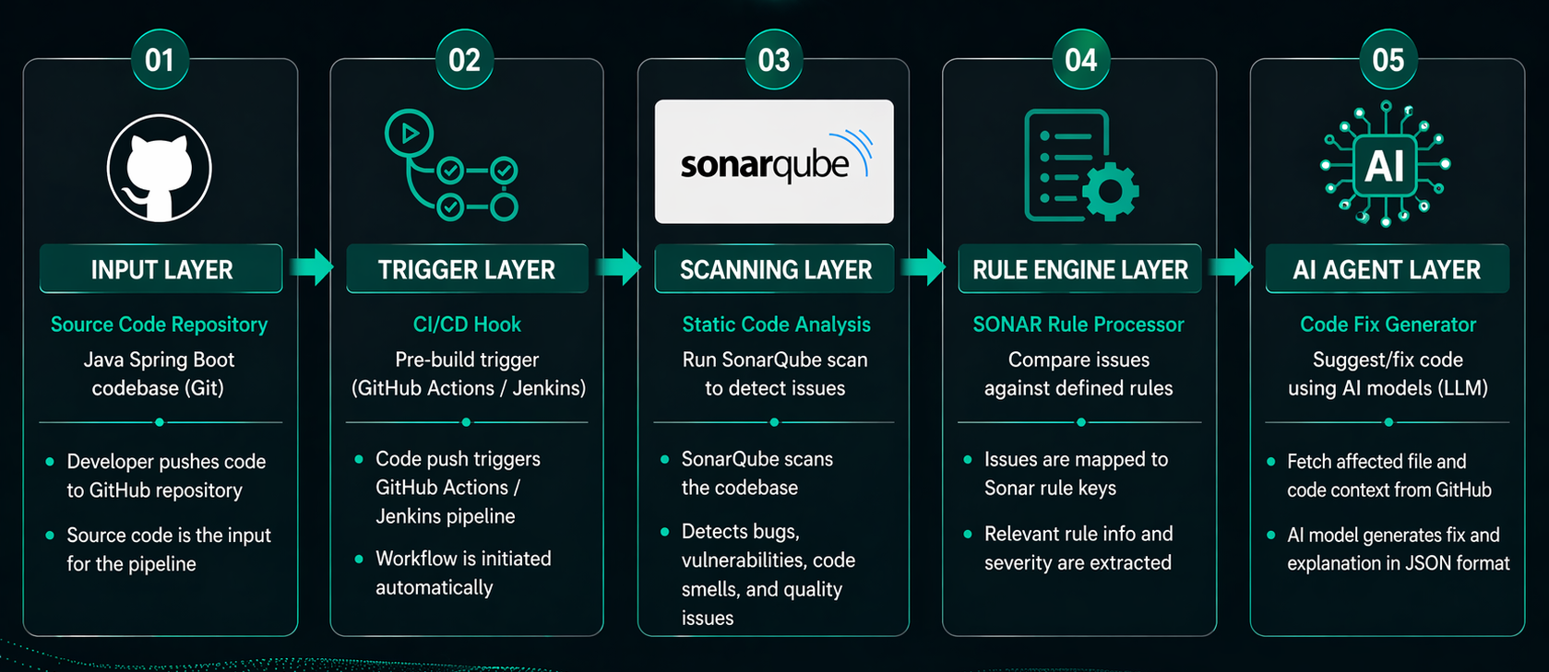
WORKFLOW

Slide 6
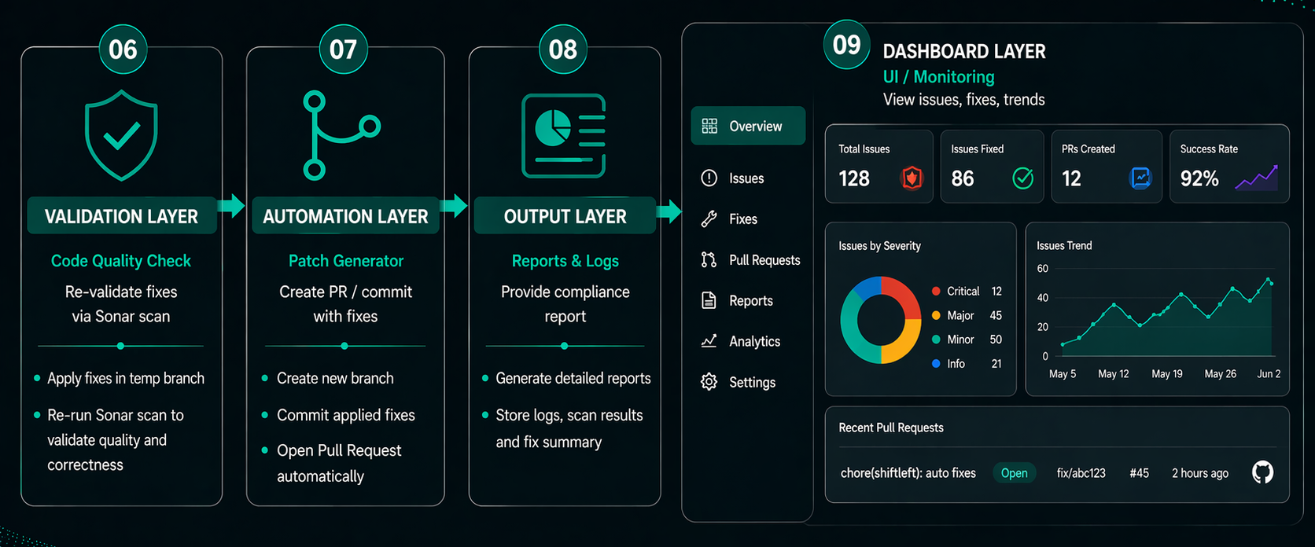
WORKFLOW

Slide 7
Phase 1: Requirement Analysis
Completed
Scope
Sonar compliance for Java Spring Boot
Focus on security, code quality, and best practices
Supported language
Java
Target: Spring Boot project
CI/CD integration
Use SonarCloud API to fetch issues
Build backend endpoints for automation
Plan future GitHub Actions / deployment

Slide 8
Phase 2: Environment Setup
Completed
Set up SonarCloud/SonarQube access and project token
Configure backend environment (venv, requirements, FastAPI)
Set up MongoDB for prompt and issue storage
Target: Java Spring Boot sample app
Verify with initial issue fetch and fix generation
Keep tokens secure and document scan/run commands

Slide 9
Phase 3: Code Scanning Integration
Completed
Integrate SonarQube into the CI/CD workflow so scans run automatically with each change.
Use Jenkins, GitHub Actions, or similar pipeline tools to orchestrate analysis steps.
Configure scanning to execute before the build step, catching issues early in the development cycle.
Enforce quality gates and block merges when critical issues are detected.
Capture scan results in the pipeline for feedback to developers and traceability.

Slide 10
Phase 4: SONAR Rule Engine
Completed
Extract:
Collect Sonar findings from code analysis, including bugs, vulnerabilities, and code smells.
Capture detailed issue metadata such as rule identifiers and affected files.
Map:
Link each issue to the corresponding Sonar rule or coding standard.
Use rule mapping to determine the remediation strategy and fix template.
Categorize:
Assign severity tiers to issues: low, medium, high.
Prioritize remediation based on impact and risk level.
Enable:
Use rule-based classification to drive focused fix recommendations.
Allow filtering and reporting by issue category and severity.

Slide 11
Phase 5: AI Agent Development (Core)
Completed
Build AI agent:
Develop the core automation that inspects code and derives remediation actions.
Connect issue data with intelligent fix generation workflows.
Analyze code issues:
Interpret static analysis findings and identify root causes.
Understand code context to recommend precise repairs.
Suggest fixes:
Generate actionable patch ideas rather than just flagging problems.
Propose targeted changes for each issue type.
Use:
Leverage LLMs or code-focused models, either open-source or via API services.
Apply model intelligence to translate issue descriptions into code corrections.

Slide 12
Phase 5: AI Agent Development (Core)
Completed
Example:
Detect and resolve null pointer risks through safer code patterns.
Improve code formatting, consistency, and readability as part of remediation.
Build AI agent:
Develop the core automation that inspects code and derives remediation actions.
Connect issue data with intelligent fix generation workflows.
Analyze code issues:
Interpret static analysis findings and identify root causes.
Understand code context to recommend precise repairs.
Suggest fixes:
Generate actionable patch ideas rather than just flagging problems.
Propose targeted changes for each issue type.

Slide 13
Phase 6: Automated Code Fixing
Completed
Use:
Leverage LLMs or code-focused models, either open-source or via API services.
Apply model intelligence to translate issue descriptions into code corrections.
Example:
Detect and resolve null pointer risks through safer code patterns.
Improve code formatting, consistency, and readability as part of remediation.

Slide 14
Phase 7: Validation Loop
Completed
Re-run:
Execute Sonar scan again after applying fixes to validate the changes.
Ensure:
Confirm that issue counts drop and severity is lowered.
Verify no new defects are introduced during remediation.
Track:
Compare before vs after metrics for issue count, severity, and quality.
Use these metrics to measure effectiveness and guide next iterations.

Slide 15
Phase 8: Reporting & Logging
Completed
Generate:
Produce compliance reports summarizing scan results and remediation activity.
Include:
Document issues found, fixes applied, and remaining unresolved issues.
Track:
Capture logs for auditability, timing, and traceability of the remediation process.

Slide 16
Phase 9: Dashboard / UI
Completed
Build using:
Use an interactive dashboard / web UI for visibility.
Present scan, fix, and quality data in a consolidated interface.
Display:
Visualize issue trends over time.
Show fix success rate and remediation effectiveness.
Present code quality metrics and compliance status.

Slide 17
Phase 10: Testing & Evaluation
Completed

